Slide 1
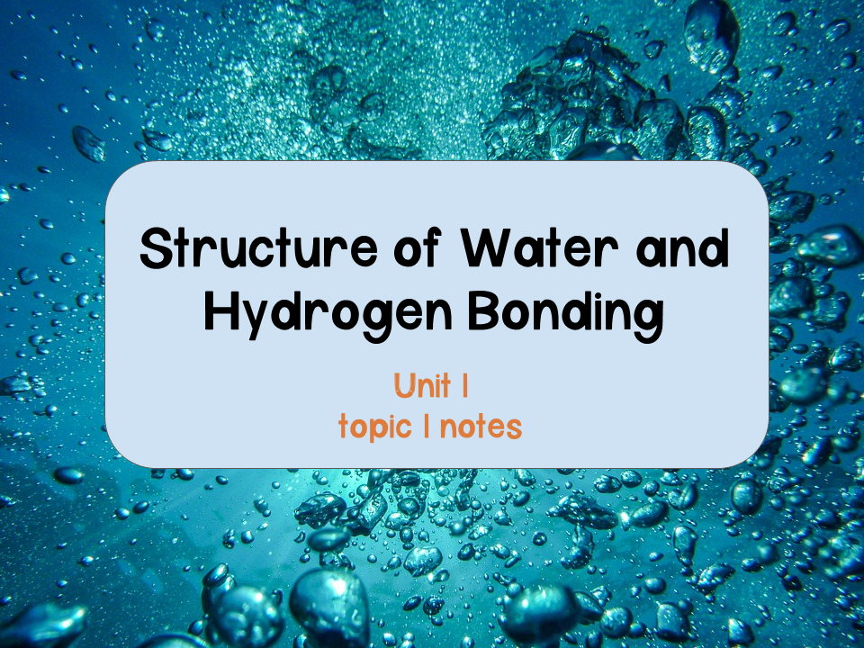

Slide 2
Chemistry Review
Matter
Element
Compound
Anything that takes up space and has mass
Rocks, metals, oils, gasses, organisms, etc. are all forms of matter
A substance that cannot be broken down into other substances by chemical reactions
92 elements occur in nature
Periodic table
A substance consisting of two or more different elements combined in a fixed ratio
H₂O
NaCl
Essential elements: of the 92 naturally occurring elements 20-25% are essential to survive and reproduce. CHON make up 96% of living matter
Trace elements: of the 92 naturally occurring elements, these are required by an organism in very small quantities
Notes:
CHON- Carbon, hydrogen, oxygen, and nitrogen

Slide 3
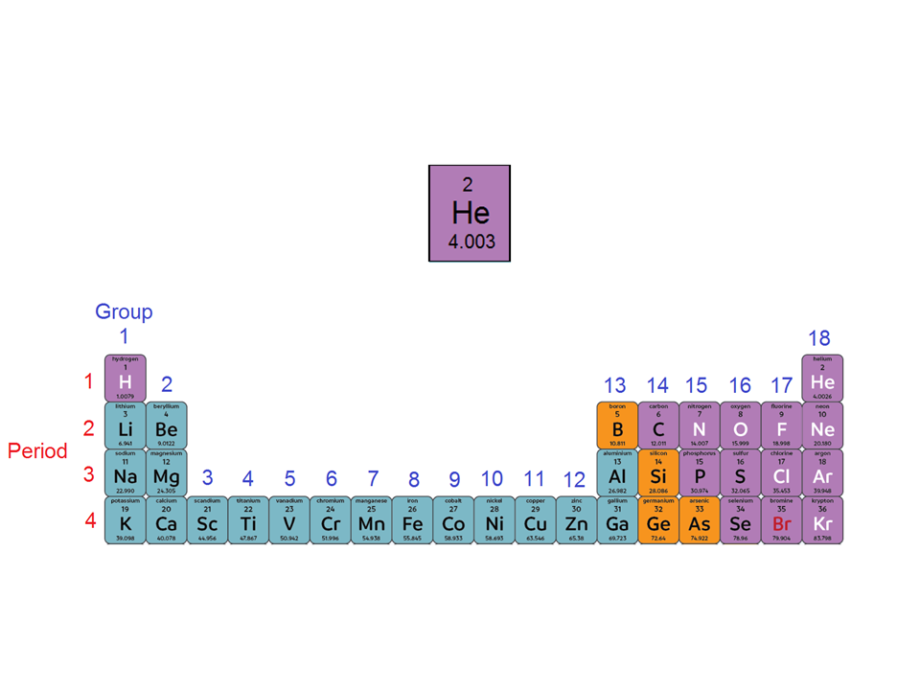
Chemistry Review
Atomic number: number of protons
Element symbol
Atomic mass: number of protons plus neutrons averaged over all isotopes

Slide 4
Chemistry Review
Elements in the same vertical column have the same number of valence electrons
Elements in the same horizontal row have the same total number of electron shells

Slide 5
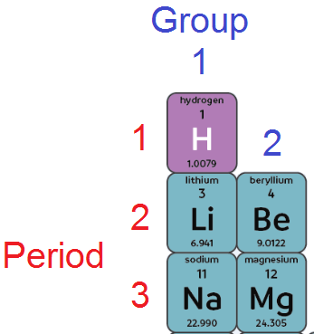

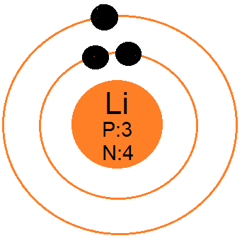
Chemistry Review
Example:Lithium
Period 2 = 2 shells
Group 1 = 1 valence e⁻
3 protons = 3 electrons
Bohr Model
Show electrons orbiting the nucleus of an atom
Electrons are placed on shells around the nucleus
Each shell is a different energy level and can hold up to a certain number of electrons
  1st shell: 2 e⁻
  2nd shell: 8 e⁻
  3rd shell: 18e⁻
Notes:
If students need extra help with drawing the Lewis dot models I show them this video https://www.youtube.com/watch?v=1ZlnzyHahvo#action=share

Slide 6

Chemistry Review
Example:Lithium
Period 2 = 2 shells
Group 1 = 1 valence e⁻
3 protons = 3 electrons
Lewis Dot Model
Simplified Bohr diagrams
  Does not show energy levels
Only shows electrons in the valence shell (outermost shell)
Electrons are placed around the element symbol
Elements want to be stable
Atoms with incomplete valence shells can interact
How do elements achieve this?
Form chemical bonds
Notes:
If students need extra help with drawing the Lewis dot models I show them this video https://www.youtube.com/watch?v=1ZlnzyHahvo#action=share

Slide 7
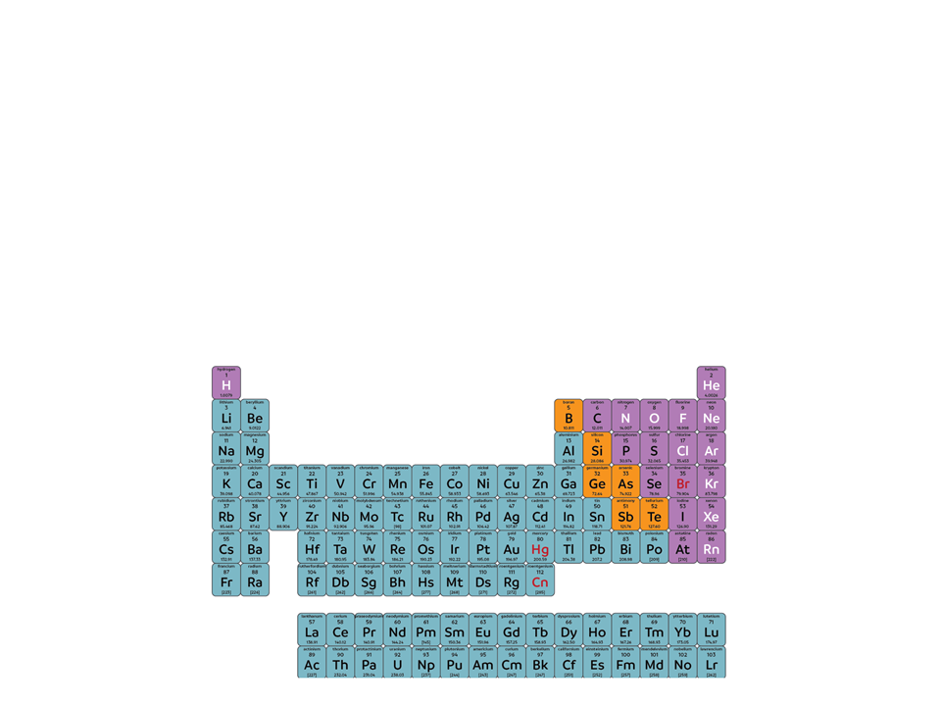
Chemistry Review
Chemical Bonds: an attraction between two atoms, resulting from the sharing or transferring of valence electrons
Electronegativity: the measure of an atom’s ability to attract electrons to itself
Electronegativity increases
Electronegativity decreases

Slide 8
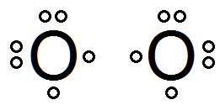
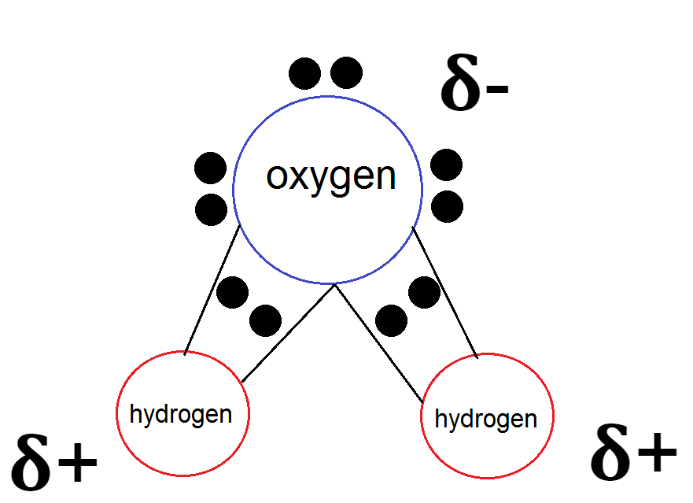

Covalent Bonds
Sharing of electrons by two atoms
Form molecules and compounds
Single bond: 1 pair of shared e⁻
Double bond: 2 pairs of shared e⁻
Triple bond: 3 pairs of shared e⁻
Nonpolar covalent
Polar covalent
Electrons are shared equally between between two atoms
O₂
Electrons are not shared equally between two atoms
H₂O
Unequal sharing of e- results in partial charges on oxygen and hydrogen
Double bond: 2 pairs shared e⁻

Slide 9
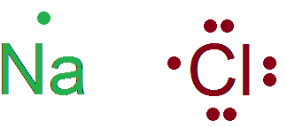
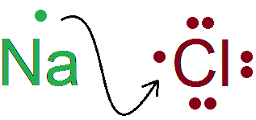
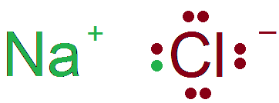
Ionic Bonds
The attraction between oppositely charged atoms (ions)
Forms ionic compounds and salts
  NaCl
  LiF
Transfer of electrons from one atom to another atom forms ions
Cation: positively charged ion
Anion: negatively charged ion
  The attraction between the anion and cation forms the ionic bond

Slide 10
Hydrogen Bonding
The partially positive hydrogen atom in one polar covalent molecule will be attracted to an electronegative atom in another polar covalent molecule
Intermolecular bond: bond that forms between molecules
Why does this happen?
When a hydrogen atom is bonded to an electronegative atom (usually O, N, or F) the electrons are not being shared equally between atoms (remember: this is a polar covalent bond)
This causes the hydrogen to have a partial positive charge and the electronegative atom to have a partial negative charge

Slide 11
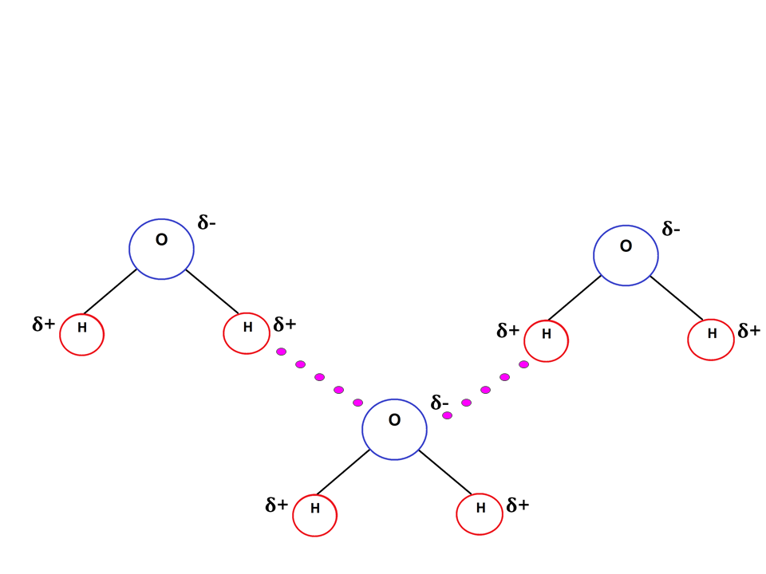
Hydrogen Bonding
Example: hydrogen bonds between water molecules
Polar covalent bond
Hydrogen bond
The hydrogen bonds between water make it more structured than most liquids
Water molecules move a lot! Hydrogen bonds form, break, and re-form with great frequency

Slide 12
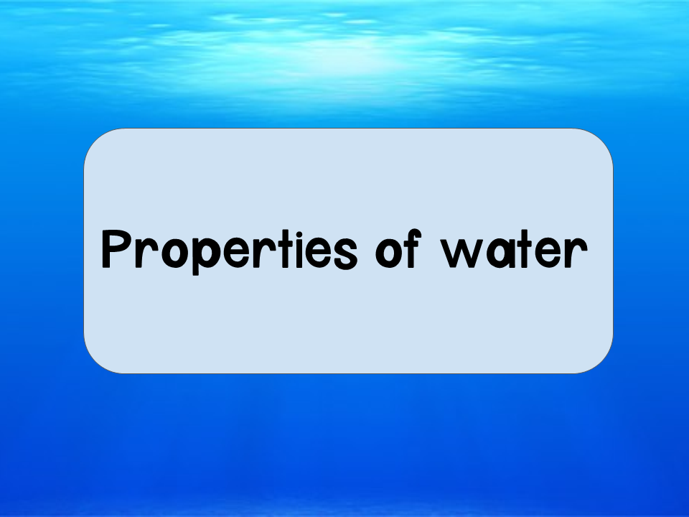

Slide 13
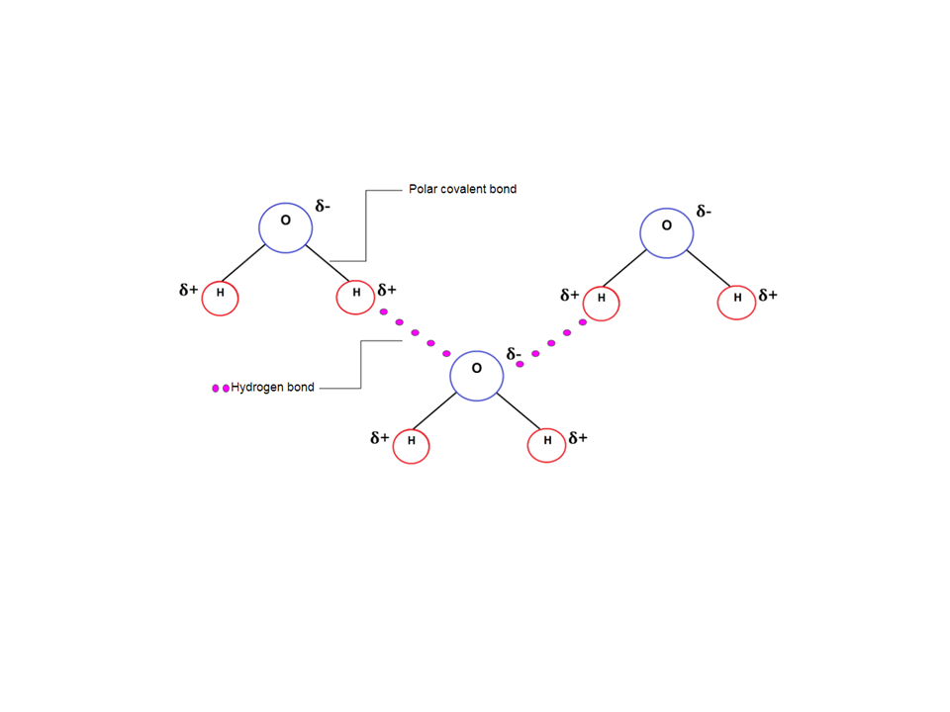
Properties of Water
Polarity
Unequal sharing of the electrons make water a polar molecule

Slide 14
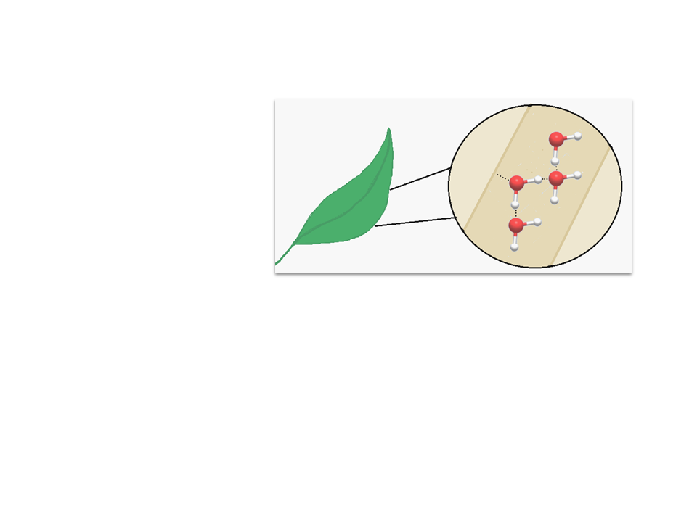
Properties of Water
Cohesion
Attraction of molecules for other molecules of the same kind
Hydrogen bonds between H₂O molecules hold them together and increase cohesive forces
Xylem of leaf
Allows for the transport of H₂O and nutrients against gravity in plants
Responsible for surface tension
Cohesion: H₂O molecules stick together
Property allowing liquid to resist external force
Notes:
https://www.youtube.com/watch?v=3jwAGWky98c

Slide 15
Properties of Water
Adhesion
The clinging of one molecule to a different molecule
Due to the polarity of H₂O
In plants, this allows water to cling to the cell walls to resist the downward pull of gravity
Xylem of leaf
Adhesion: H₂O molecules stick to the xylem wall
Notes:
https://www.youtube.com/watch?v=3jwAGWky98c

Slide 16
Properties of Water
Capillary Action
The upward movement of water due to the forces of cohesion, adhesion, and surface tension
Occurs when adhesion is greater than cohesion
  Important for transport of water and nutrients in plants
Xylem of leaf
Capillary action occurs moving water upwards
Notes:
https://www.youtube.com/watch?v=3jwAGWky98c

Slide 17
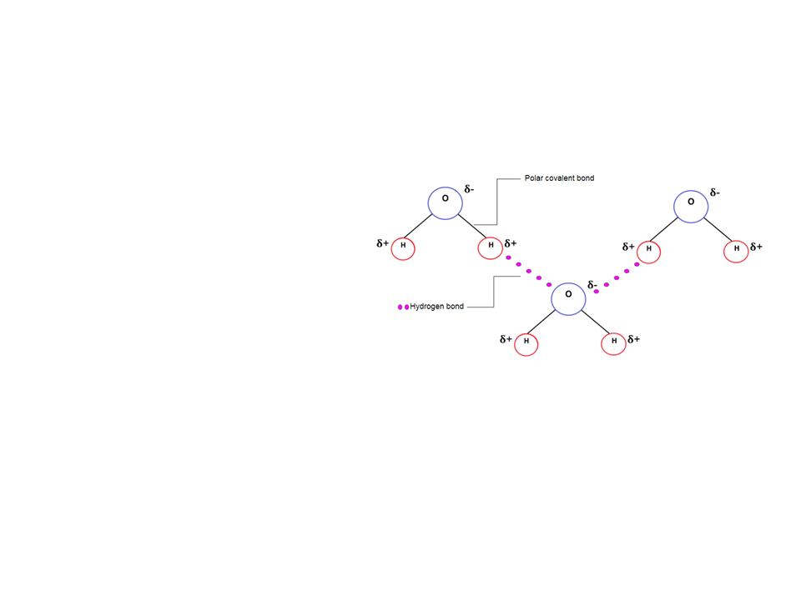
Properties of Water
Temperature Control
High Specific Heat
H₂O resists changes in temperature
How?
Hydrogen bonds! Heat must be absorbed to break hydrogen bonds, but heat is released when hydrogen bonds form
Temp control properties of H₂O stem from these hydrogen bonds
2. Stabilizes ocean temp
Benefits marine life
  3. Organisms (which are made primarily of H₂O) can resist changes in their own internal temp
1. Moderates air temperature
Large bodies of water can absorb heat in the daytime and release heat at night
Notes:
https://www.youtube.com/watch?v=3jwAGWky98c

Slide 18
Properties of Water
Evaporative Cooling
Water has a high heat of vaporization (same reasons as high specific heat)
The molecules with the highest kinetic energy leave as gas
Moderates Earth’s climate
Stabilizes temp in lakes and ponds
Prevents terrestrial organisms from overheating (think sweating in humans)
Prevents leaves from becoming too warm in the sun
Notes:
https://www.youtube.com/watch?v=3jwAGWky98c

Slide 19
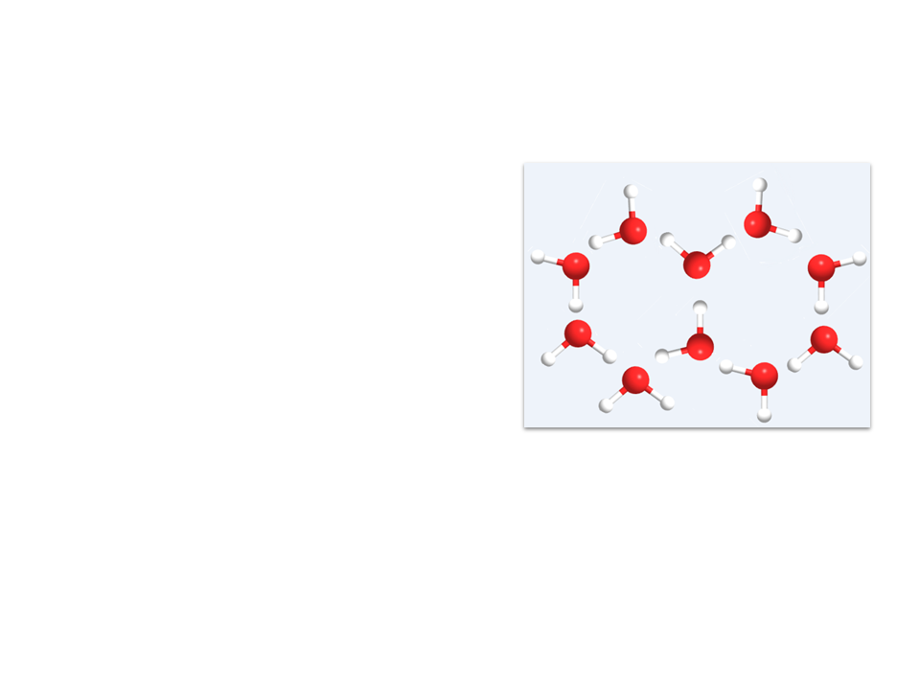
Properties of Water
Floating Ice
As water solidifies it expands and becomes less dense
Due to the hydrogen bonds
  When cooled, H₂O molecules move too slowly to break the bonds
    Allows marine life to survive under floating ice sheets

Slide 20
Properties of Water
Hydrogen bonds cause water molecules to form a crystalline structure
Quick! Think, Pair, Share
Imagine the 3D crystalline structure of ice. How many hydrogen bonds can one molecule of water make with its neighboring water molecules?
Answer: four

Slide 21
Properties of Water
Solvent
Water is a versatile solvent: its polar molecules are attracted to ions and other polar molecules it can form hydrogen bonds with
Solution: homogenous mix of 2+ substances
Solvent: dissolving agent in a solution
Solute: substance that is dissolved
Notes:
A great summary video to show your students https://www.youtube.com/watch?v=iOOvX0jmhJ4

Slide 22
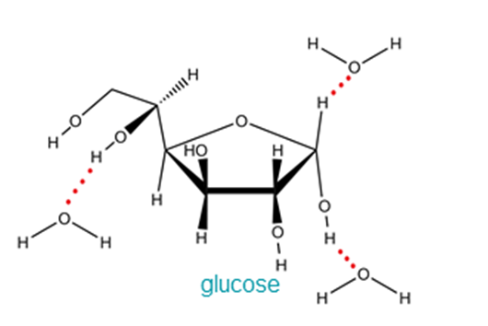
Properties of Water
“Like dissolves like”
  Water can interact with sugars or proteins containing many oxygen and hydrogen
    Water will form hydrogen bonds with the sugar or protein to dissolve it
Notes:
A great summary video to show your students https://www.youtube.com/watch?v=iOOvX0jmhJ4

Slide 23
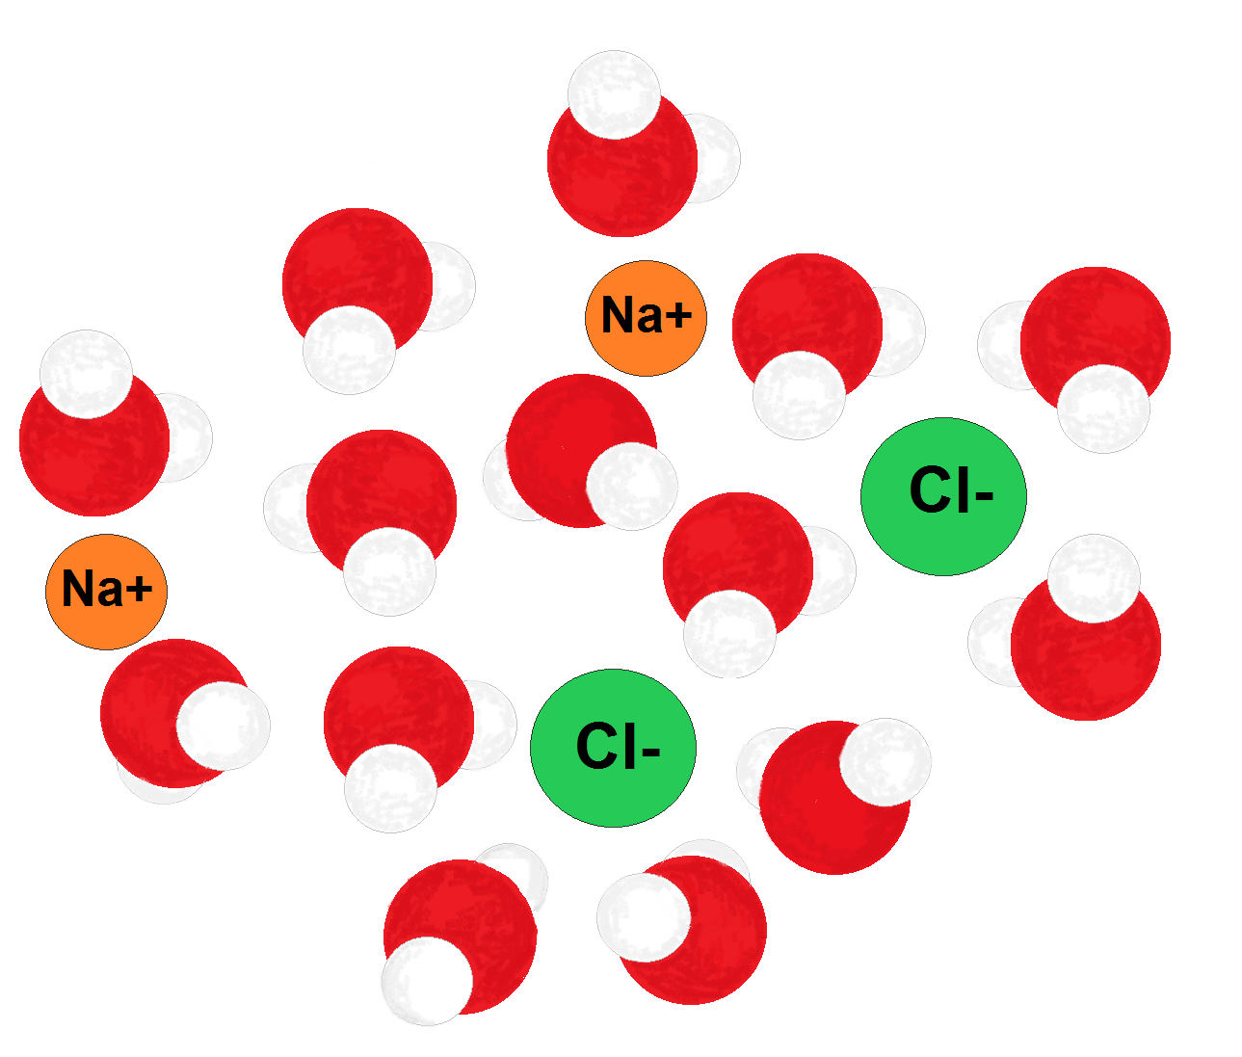
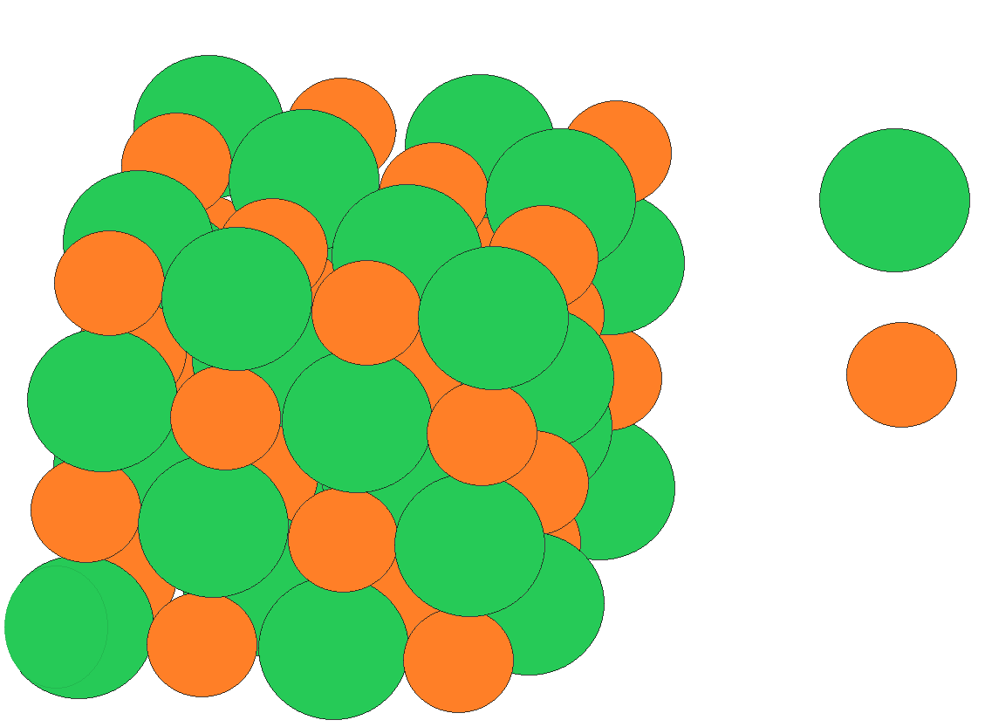
Properties of Water
Ionic compounds
The partially negative oxygen in water will interact with a positive atom
The partially positive hydrogen in water will interact with a negative atom
  Dissolves ions
Cl-
Na+
Na+ surrounded by oxygen
Cl- surrounded by hydrogen
Notes:
A great summary video to show your students https://www.youtube.com/watch?v=iOOvX0jmhJ4

Slide 24
Concept Check
Describe what would happen if you mix potassium chloride (KCl) with water. Draw and label a diagram to justify your explanation.
Identify one quality of water that most directly contributes to its unique properties.
Identify one property of water that contributes to the suitability of the environment for marine life.
Predict one disruption that would occur in the environment if ice was MORE dense than water

Slide 25
Practice FRQ
Describe three properties of water to justify the following statement, “Water is essential to all life.”
Notes:
Check student responses. They can discuss any of the properties of water covered, but they must be able to justify their responses appropriately.

Slide 26
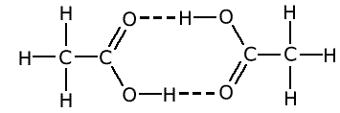
Practice FRQ
The diagram above represents two molecules of ethanoic acid hydrogen bonded together. Using the diagram a) label the hydrogen bonds and b) discuss the partial charges associated with the hydrogen bonds labeled.
Notes:
There are two hydrogen bonds in the diagram, both are represented by the dashed lines.
For both hydrogen bonds shown, the hydrogens would have a partial positive charge and the oxygens would have a partial negative charge.

